Slide 1


CECS 571 Project 2
Keshav Bhojanapally(026731937)
Aishwarya Bhosale(026735915)
Apoorva Uppala(026697591)

Slide 2

Criteria for choosing the dataset
Availability of the dataset.
Relationship between datasets
Format of the datasets.
Is it able to answer complex questions?

Slide 3
Datasets
Calls for service(emergency calls) during the year 2019.
Total number of electronic police reports during the year 2019.

Slide 4
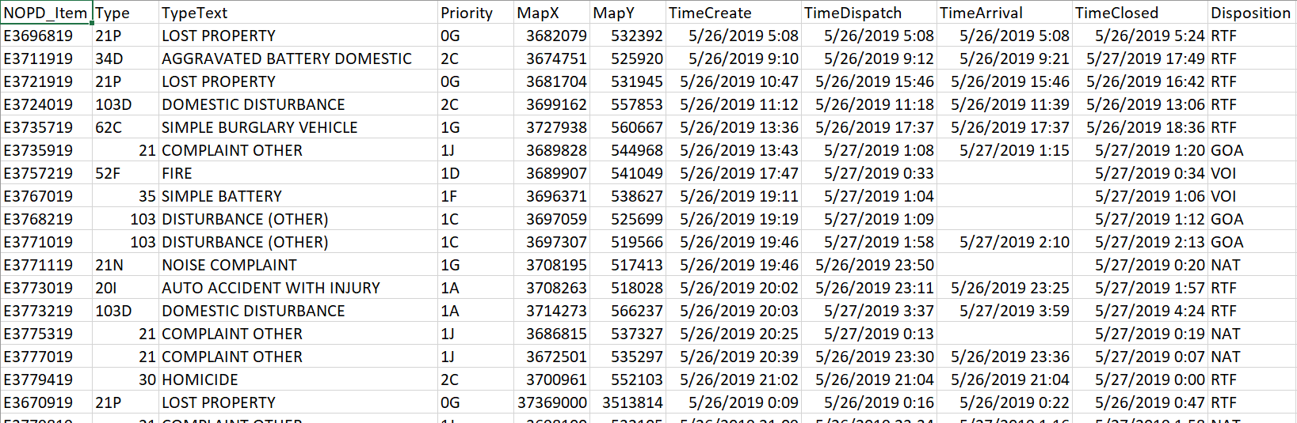
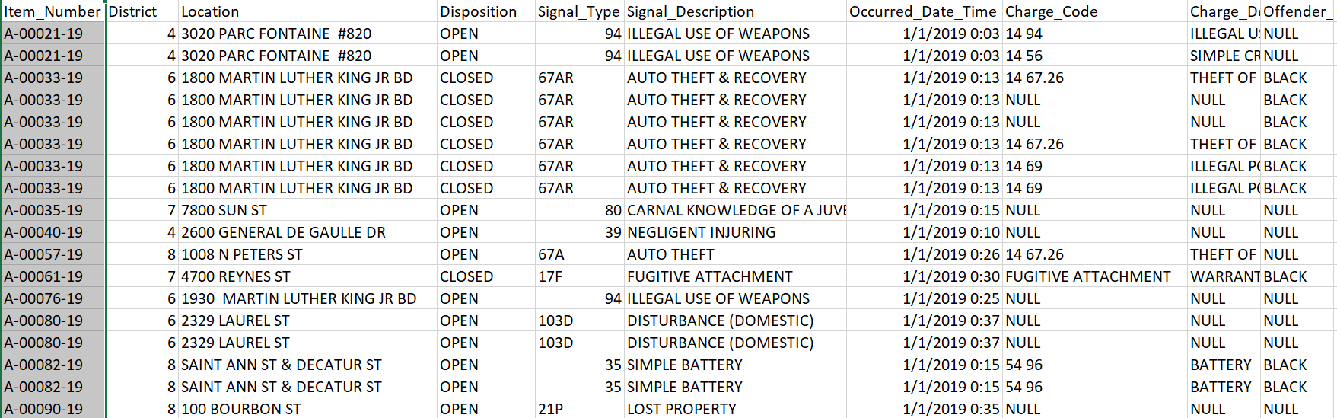
Calls for Service 2019
Electronic Police Report 2019

Slide 5

Questions answered using the datasets
Given a month, how many incidents are requested and responded ?
On an average how many incidents are reported and out of them how many of them are still open?

Slide 6
Frameworks used
Apache Jena is an open-source Semantic Web framework for Java. It provides an API to extract data from and write to RDF graphs.
Maven is a build automation tool used primarily for Java projects. Maven can also be used to build and manage projects written in C#, Ruby, Scala, and other languages.

Slide 7
Steps to convert from CSV to RDF
Defining Ontology Design
Defining classes, properties and relations.
Building
Generating the classes, properties and triplets using Apache Jena.
Parsing
Reading and parsing the csv and converting them into Java Models.
Creating RDF
Create instances of the classes defined.

Slide 8
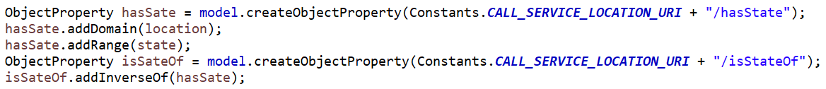
Building Model ,class and property
Model:
Class:
Property:

Slide 9
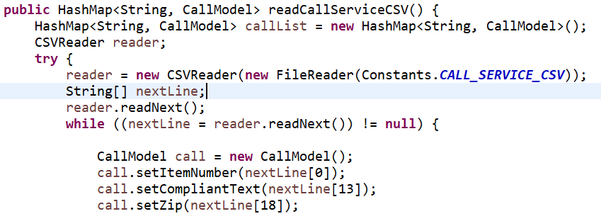
Parsing CSV
Storing instances in model:
Read CSV with columns:

Slide 10
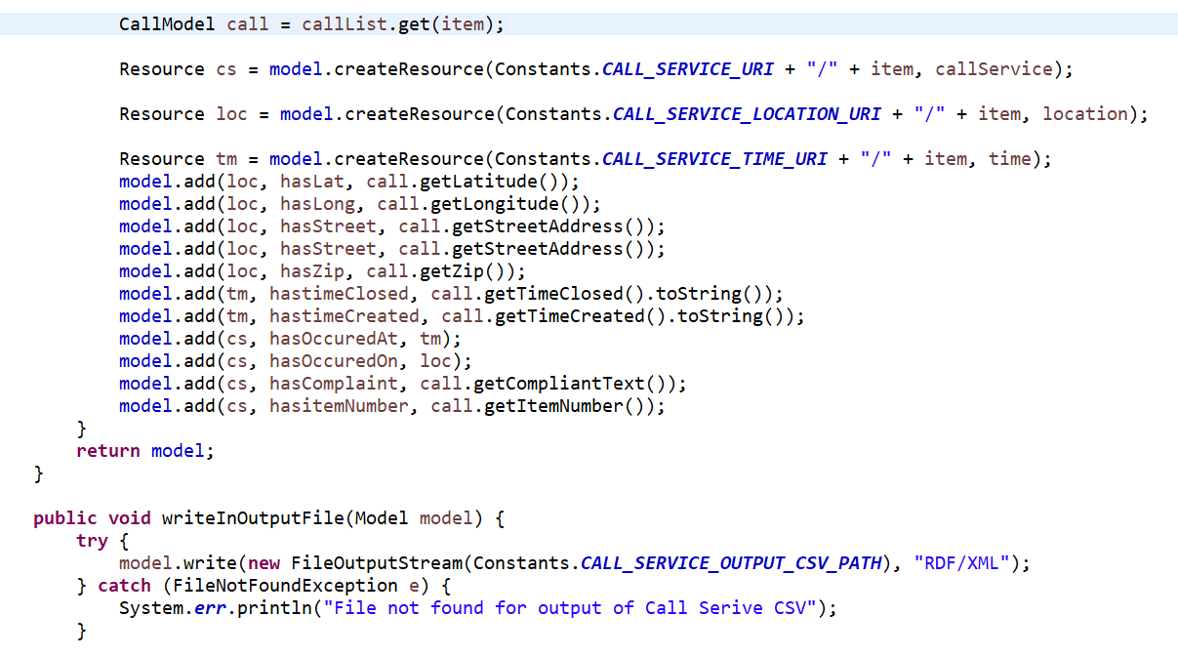
Creating Model instances

Slide 11
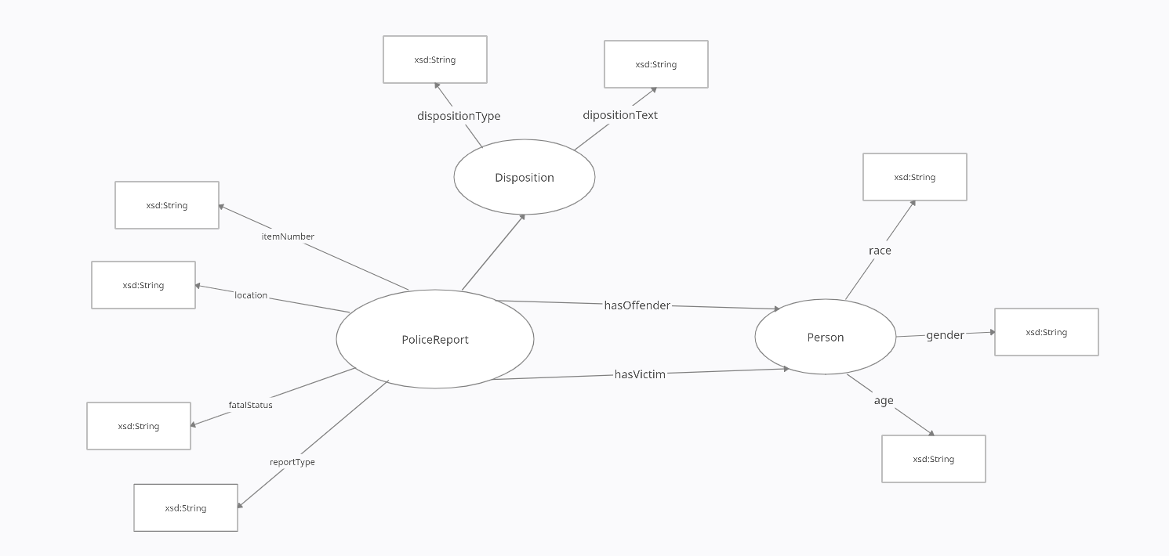
Police Report

Slide 12
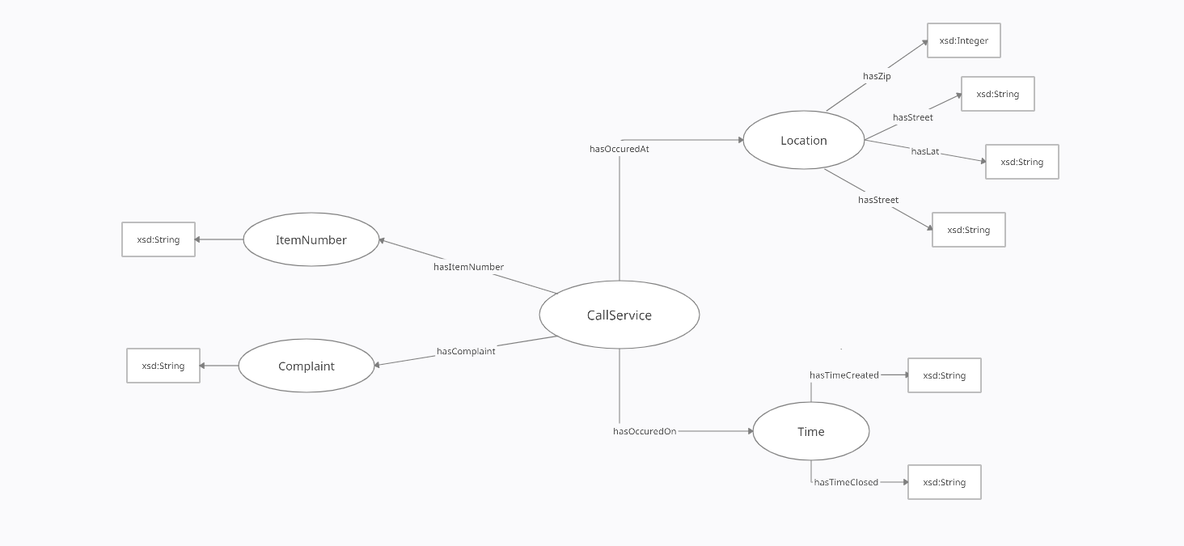
Call Service

Slide 13
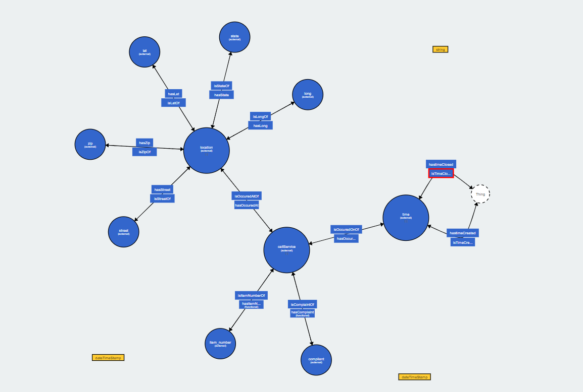
RDF Visualization

Slide 14

Technical Challenges Faced
To choose a dataset from data.gov
To analyze the datasets and decide on which columns to include.
Of the available data, how to form classes and find relation among them.
To define relations between the two datasets to help them answer questions.
To clean the dataset to remove the incomplete information.

Slide 15

Thank You

